Slide 1

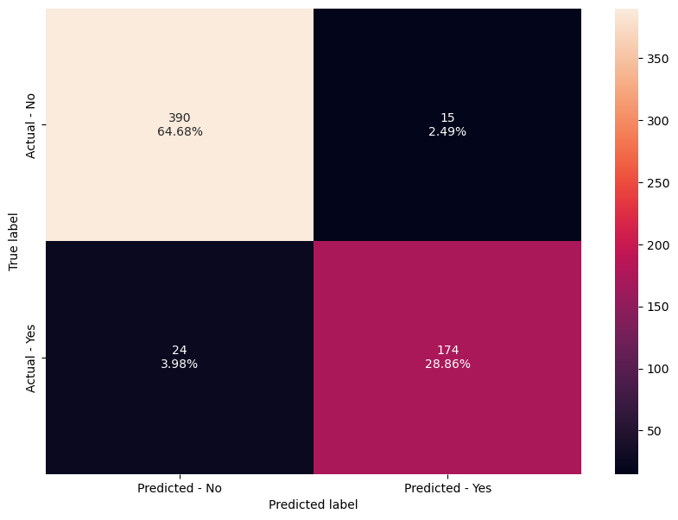
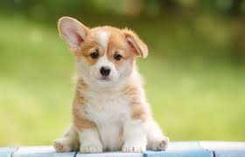
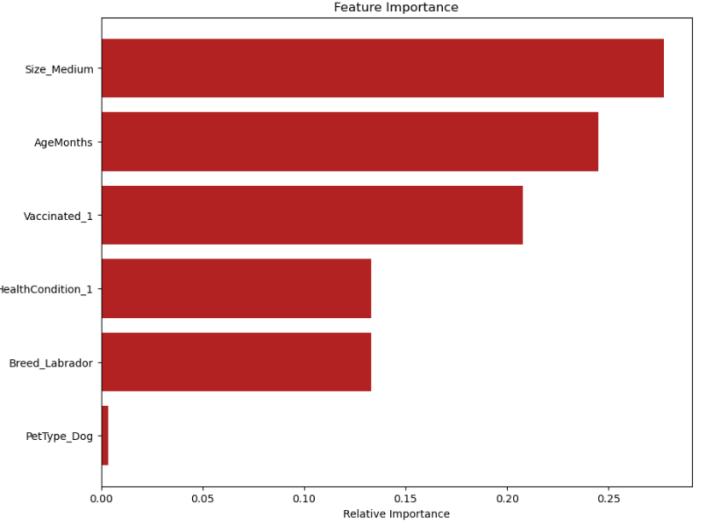
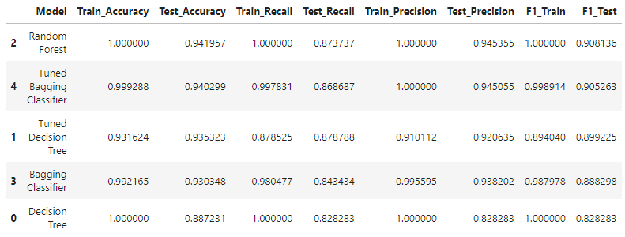
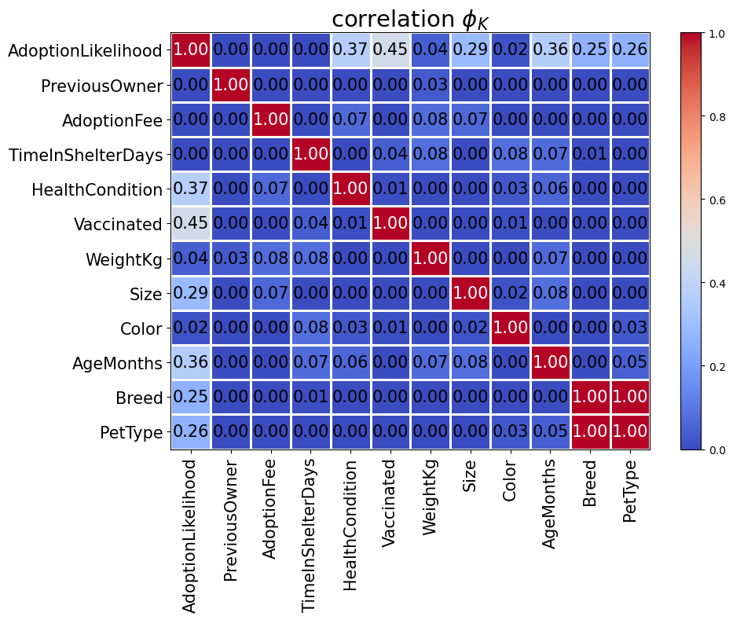
Prediction of Pet Adoption Likelihood Using Machine Learning
Dolineaschi Tudor | Stanford Pre-Collegiate Summer Institutes
Introduction
Pet adoption is a compassionate and fulfilling way to bring a new furry friend into your home. By adopting a pet, you not only provide a loving home to an animal in need but also contribute to reducing the number of homeless pets and the overpopulation in shelters. Adopting a pet from a shelter or rescue organization is a responsible choice that offers numerous benefits both for the pet and the adopter.
AgeMonths (I/R)
Color (nominal)
Size (ordinal)
WeightKg (I/R)
Vaccinated (I/R)
HealthCondition (I/R)
TimeInShelterDays (I/R)
AdoptionFee (I/R)
PreviousOwner (I/R)
Dependent Variables:
1.AdoptionLikelihood (I/R)
Machine Learning Models
The sole purpose of this data set is to predict if a pet is likely or not to be adopted. This makes it a binary classification task for a supervised model.
I used six machine learning models:
Random Forest
Tuned Random Forest
Decision Tree
Bagging Classifier
Tuned Decision Tree
Tuned Bagging Classifier
Graphic Elements
Confusion Matrix:
Methods:
Preprocessing the data
Exploratory data analysis
Splitting the data
Model training and selection
Data Analysis
Using a phi-k correlation matrix I found out that the most strongly correlated features with the likeliness of being adopted are:
Vaccinated: Vaccination status of the pet (0 - Not vaccinated, 1 - Vaccinated).
HealthCondition: Health condition of the pet (0 - Healthy, 1 - Medical condition).
AgeMonths: Age of the pet in months.
0 to 0.1: Little to no association
0.1 to 0.3: Weak association
0.3 to 0.5: Moderate association
0.5 to 0.7: Strong association
0.7 to 1.0: Very strong association
Graph:
Results & Conclusion
After running all the models, the most efficient one that was not overfitting the data was the Tuned Decision Tree.
Features Importance:
Figure A: neque dignissim, and in aliquet nisl et umis.
The Dataset
The Pet Adoption Dataset provides a comprehensive look into various factors that can influence the likelihood of a pet being adopted from a shelter. This dataset includes detailed information about pets available for adoption, covering various characteristics and attributes. There where significantly less results for pets unlikely to be adopted than likely. One column was removed from the data because it did not affect the result in any way..
Independent Variables:
PetID (removed)
PetType (nominal)
Breed (nominal)
References
https://www.kaggle.com/datasets/rabieelkharoua/predict-pet-adoption-status-dataset
file:///C:/Users/test/OneDrive/Desktop/PetAdoption.html
https://chatgpt.com
https://images.google.com
Both the Random Forest and Tuned Bagging Classifier seemed to perform better based on F1, but were overfitting the data.

